Slide 1
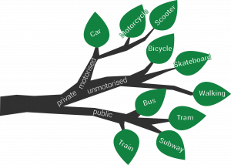
Decision Tree

Slide 2
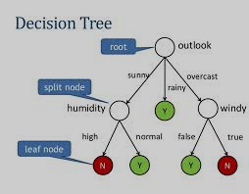
Decision tree
Decision tree builds classification or regression models in the form of a tree structure. It breaks down a dataset into smaller and smaller subsets while at the same time an associated decision tree is incrementally developed.
The final result is a tree with decision nodes and leaf nodes.
A decision node (e.g., Outlook) has two or more branches (e.g., Sunny, Overcast and Rainy). Leaf node (e.g., Play) represents a classification or decision.
The topmost decision node in a tree which corresponds to the best predictor called root node.

Slide 3
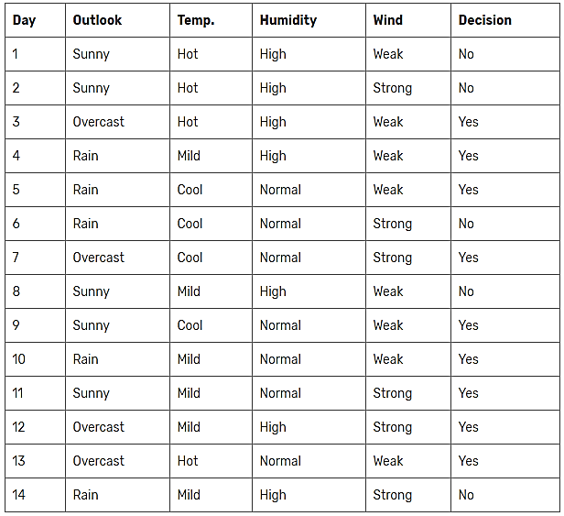
Decision tree: ID3 Algorithm
ID3 Iterative Dichotomiser is one of the most common decision tree algorithm.
We can summarize the ID3 algorithm as illustrated below
Entropy(S) = ∑ – p(I) . log₂p(I)
Gain(S, A) = Entropy(S) – ∑ [ p(S|A) .Entropy(S|A) ]

Slide 4
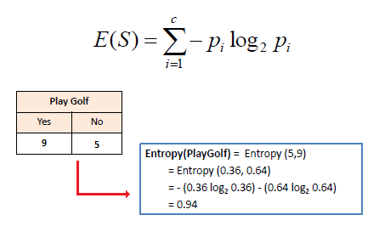
ID3 Algorithm
We need to calculate the entropy first. Decision column consists of 14 instances and includes two labels: yes and no. There are 9 decisions labeled yes, and 5 decisions labeled no.
Entropy(Decision) = – p(Yes) . log₂p(Yes) – p(No) . log₂p(No)
Entropy(Decision) = – (9/14) . log₂(9/14) – (5/14) . log₂(5/14) = 0.940
Now, we need to find the most dominant factor for decision.

Slide 5
Wind factor on decision
Gain(Decision, Wind) = Entropy(Decision) – ∑ [ p(Decision|Wind) . Entropy(Decision|Wind) ]
Wind attribute has two labels: weak and strong. We would reflect it to the formula.
Gain(Decision, Wind) = Entropy(Decision) – [ p(Decision|Wind=Weak) . Entropy(Decision|Wind=Weak) ] – [ p(Decision|Wind=Strong) . Entropy(Decision|Wind=Strong) ]
Now, we need to calculate (Decision|Wind=Weak) and (Decision|Wind=Strong) respectively.

Slide 6
Weak wind factor on decision
Day | Outlook | Temp. | Humidity | Wind | Decision
1 | Sunny | Hot | High | Weak | No
3 | Overcast | Hot | High | Weak | Yes
4 | Rain | Mild | High | Weak | Yes
5 | Rain | Cool | Normal | Weak | Yes
8 | Sunny | Mild | High | Weak | No
9 | Sunny | Cool | Normal | Weak | Yes
10 | Rain | Mild | Normal | Weak | Yes
13 | Overcast | Hot | Normal | Weak | Yes
There are 8 instances for weak wind. Decision of 2 items are no and 6 items are yes as illustrated below.
1- Entropy(Decision| Wind=Weak) = – p(No) . log₂p(No) – p(Yes) . log₂p(Yes)
2- Entropy(Decision| Wind=Weak) = – (2/8) . log₂(2/8) – (6/8) . log₂(6/8) = 0.811

Slide 7
Strong wind factor on decision
Day | Outlook | Temp. | Humidity | Wind | Decision
2 | Sunny | Hot | High | Strong | No
6 | Rain | Cool | Normal | Strong | No
7 | Overcast | Cool | Normal | Strong | Yes
11 | Sunny | Mild | Normal | Strong | Yes
12 | Overcast | Mild | High | Strong | Yes
14 | Rain | Mild | High | Strong | No
Here, there are 6 instances for strong wind. Decision is divided into two equal parts.
1- Entropy(Decision|Wind=Strong) = – p(No) . log₂p(No) – p(Yes) . log₂p(Yes)
2- Entropy(Decision|Wind=Strong) = – (3/6) . log₂(3/6) – (3/6) . log₂(3/6) = 1
Now, we can turn back to Gain(Decision, Wind) equation.
Gain(Decision, Wind) = Entropy(Decision) – [ p(Decision|Wind=Weak) . Entropy(Decision|Wind=Weak) ] – p(Decision|Wind=Strong) . Entropy(Decision|Wind=Strong) ]
= 0.940 – [ (8/14) . 0.811 ] – [ (6/14). 1] = 0.048

Slide 8
Other factors on decision
Now, we can turn back to Gain(Decision, Wind) equation.
Gain(Decision, Wind) = Entropy(Decision) – [ p(Decision|Wind=Weak) . Entropy(Decision|Wind=Weak) ] – p(Decision|Wind=Strong) .Entropy(Decision|Wind=Strong) ]
= 0.940 – [ (8/14) . 0.811 ] – [ (6/14). 1] = 0.048
Similar calculation on the other columns.
1- Gain(Decision, Outlook) = 0.246
2- Gain(Decision, Temperature) = 0.029
3- Gain(Decision, Humidity) = 0.151

Slide 9
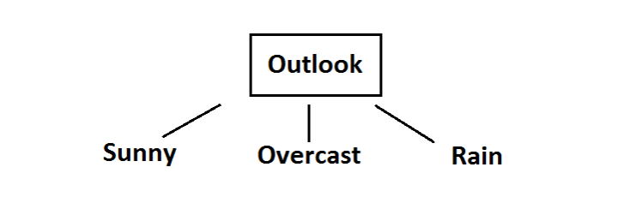
Root node Selection
As seen, outlook factor on decision produces the highest score. That’s why, outlook decision will appear in the root node of the tree.
Now, we need to test dataset for custom subsets of outlook attribute.

Slide 10
Overcast outlook on decision
Day | Outlook | Temp. | Humidity | Wind | Decision
3 | Overcast | Hot | High | Weak | Yes
7 | Overcast | Cool | Normal | Strong | Yes
12 | Overcast | Mild | High | Strong | Yes
13 | Overcast | Hot | Normal | Weak | Yes
Decision will always be yes if outlook is overcast.

Slide 11
Sunny outlook on decision
Day | Outlook | Temp. | Humidity | Wind | Decision
1 | Sunny | Hot | High | Weak | No
2 | Sunny | Hot | High | Strong | No
8 | Sunny | Mild | High | Weak | No
9 | Sunny | Cool | Normal | Weak | Yes
11 | Sunny | Mild | Normal | Strong | Yes
Here, there are 5 instances for sunny outlook. Decision would be probably 3/5 percent no, 2/5 percent yes.
1- Gain(Outlook=Sunny| Temperature) = 0.570
2- Gain(Outlook=Sunny| Humidity) = 0.970
3- Gain(Outlook=Sunny| Wind) = 0.019
Now, humidity is the decision

Slide 12
Decision
Day | Outlook | Temp. | Humidity | Wind | Decision
1 | Sunny | Hot | High | Weak | No
2 | Sunny | Hot | High | Strong | No
8 | Sunny | Mild | High | Weak | No
Now, humidity is the decision because it produces the highest score if outlook were sunny.
At this point, decision will always be no if humidity were high.
Day | Outlook | Temp. | Humidity | Wind | Decision
9 | Sunny | Cool | Normal | Weak | Yes
11 | Sunny | Mild | Normal | Strong | Yes
On the other hand, decision will always be yes if humidity were normal
Finally, it means that we need to check the humidity and decide if outlook were sunny.

Slide 13
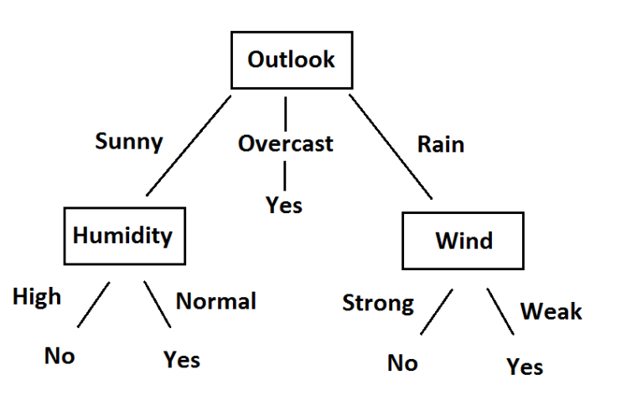
Decision
Finally, it means that we need to check the humidity and decide if outlook were sunny.

Slide 14
Rain outlook on decision
Day | Outlook | Temp. | Humidity | Wind | Decision
4 | Rain | Mild | High | Weak | Yes
5 | Rain | Cool | Normal | Weak | Yes
6 | Rain | Cool | Normal | Strong | No
10 | Rain | Mild | Normal | Weak | Yes
14 | Rain | Mild | High | Strong | No
1-Gain(Outlook=Rain | Temperature)
2- Gain(Outlook=Rain | Humidity)
3- Gain(Outlook=Rain | Wind)
Here, wind produces the highest score if outlook were rain. That’s why, we need to check wind attribute in 2nd level if outlook were rain.

Slide 15
Decision
Day | Outlook | Temp. | Humidity | Wind | Decision
4 | Rain | Mild | High | Weak | Yes
5 | Rain | Cool | Normal | Weak | Yes
10 | Rain | Mild | Normal | Weak | Yes
So, Decision will always be yes if wind were weak and outlook were rain.
Day | Outlook | Temp. | Humidity | Wind | Decision
6 | Rain | Cool | Normal | Strong | No
14 | Rain | Mild | High | Strong | No
And decision will be always no if wind were strong and outlook were rain.

Slide 16
Decision tree Construction
So, decision tree construction is over. We can use the following rules for decisioning.

